Slide 1
Key Markers for Promoting Responsible Recruitment of Migrant Workers
Guidance for companies
Developed in collaboration with the Fair Labor Association (FLA)
Andy Hall
Independent Migrant Worker Rights Specialist
16th May 2024

Slide 2
Introduction
Recruitment can be decisive in determining workers’ employment experiences
  Decent work depends on responsible recruitment
  Forced labour stems from irresponsible recruitment
Risks of irresponsible recruitment
  Placements fees and related costs, debt bondage
  Deception, contract substitution
  Threats and intimidation, inhumane treatment
  Limited freedom of movement, document confiscation
Developing international standards
Significant challenges in promoting responsible recruitment
Need recommendations to identify irresponsible practices
Responsible recruitment = responsible business conduct = human rights due diligence

Slide 3
What is responsible recruitment?
Responsible, ethical and fair recruitment
Broader than workers paying exorbitant costs or the Employer Pays Principle (EPP)
Comprehensive programmes linked to international standards
  Stronger Together’s Responsible Recruitment Toolkit (RRT) and Clearview standard
  The International Labour Organisation (ILO)’s Fair Recruitment Initiative
  The International Organisation for Migration (IOM)’s International Recruitment Integrity System (IRIS)
  The Fair Hiring Initiative (FHI)’s On The Level certification scheme
  The Responsible Business Alliance’s (RBA) Responsible Recruitment Programme and Responsible Labour Initiative, linked to the RBA standard
Recent SEDEX Collective Action Requirement (CAR) re: Employer Pays Principle
Some brands, buyers and social compliance frameworks require responsible recruitment and/or the EPP including FLA, AAFA, RBA
  *Often subset of forced labour or voluntary employment standards

Slide 4
Why a lack of progress?
More focus, funding, guidelines and commitments BUT limited real-world progress
Certification slow as gap between theoretical requirements and reality on the ground
“Responsible” actors see limited benefit
Misunderstanding on cause of irresponsible recruitment
  Workers pay because of/to source country actors?
  ‘Kickbacks’ to destination country actors/employers
Misunderstanding regarding root cause of problem prevents effective, sustainable solutions

Slide 5
“Kickbacks”
Limited demand for responsible recruitment
Source country actors must pay kickbacks
Source country actors not provided full costs
Workers pay for recruitment as costs passed to them
Few actors consider benefits of responsible recruitment
Responsible actors find it difficult to secure business

Slide 6
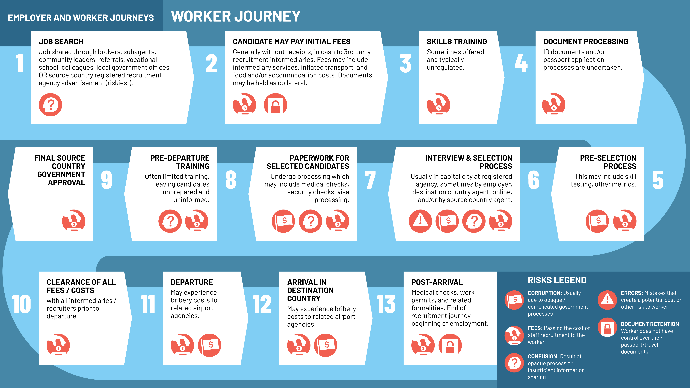

Slide 7
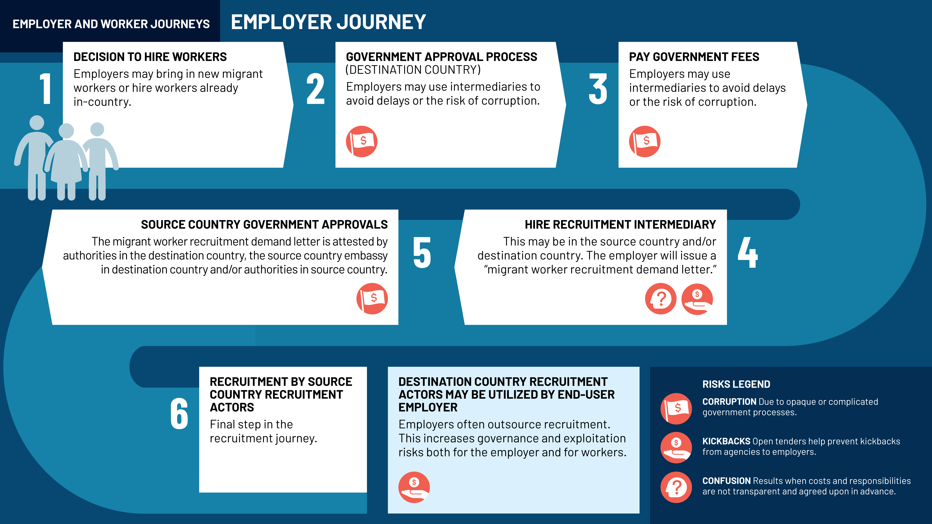

Slide 8
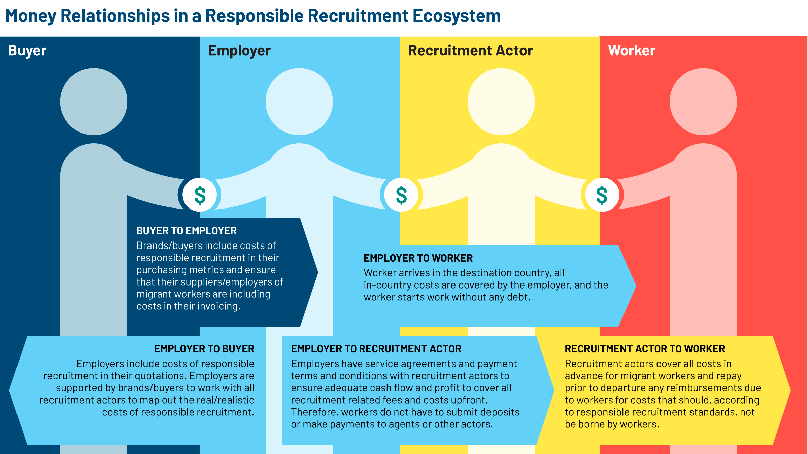

Slide 9
How to monitor recruitment?
Identifying challenges in recruitment difficult currently
Monitoring often happens only once a worker arrives at workplace
Specific techniques required for monitoring
Specific issues to look out for and request during audits

Slide 10
Responsible recruitment and leverage
Brands, buyers (and investors) have important role
Key to incentivising responsible recruitment
Targeted, informed engagement with supply chains pivotal in contributing to fair, transparent business environment for a responsible recruitment market to emerge
Contribute to responsible recruitment market demand
Ensure and monitor for (demand) responsible recruitment
Then suppliers/end-user employers demand and ensure, through suitable labour sourcing practices, responsible recruitment

Slide 11
Guidance document
WILL NOT provide more comprehensive and prescriptive advice
  Most companies have policies
  Existing programmes provide much material
WILL provide 15 key markers
WILL provide advice for effective monitoring
WILL provide ways to promote ethical recruitment market through open and transparent tender processes
HIGHLIGHTS critical areas to prioritise in developing, implementing and monitoring recruitment processes
Guidance complements certification programmes
What is needed now is responsible recruitment PILOT PROJECTS

Slide 12
 | MARKER
1 | Ensure a “good governance”-focused responsible recruitment policy
2 | Direct worker sourcing policy
3 | Do not confiscate or retain workers’ personal documents
4 | Organize training programs on responsible recruitment
5 | Allocate an appropriate budget for responsible purchasing practices
6 | Avoid using destination country recruitment actors or intermediaries
7 | Promote an open tender recruitment agency selection process
8 | Create a realistic recruitment timeline and payment schedule
9 | Impose realistic warranty conditions on recruiters
10 | Ensure independent third-party monitoring and verification, including grievance mechanisms
11 | Maintain a fair and open candidate selection process during recruitment
12 | Provide adequate, accessible information on employment
13 | Guarantee access to remedy and accountability
14 | Encourage source country agency due diligence practices toward end-user employers
15 | Encourage humane treatment of workers
15 Key Markers

Slide 13
Marker 1: Ensure a “good governance”-focused responsible recruitment policy
Policies consistent with ensuring ‘good governance’ and preventing corruption
Background: policy commitments start of a process only
Background: many actors, more than required
Background: ‘Kickback process’ prevalent, corruption undermines policy
Do not engage in or become complicit in corruption or financial crime
Focus on good governance included in existing responsible recruitment policies
Specific mention of risks of kickback and need to prevent these
Significant damage can result for brands, buyers and suppliers

Slide 14
How to Prevent Kickbacks?
Recruitment processes interactively agreed with input from experts and stakeholders IN ADVANCE
    Recruitment stages
    Costs
    Timelines
    Responsibilities
    Negotiated
    Triangulated
Recruitment costs paid through banking systems by employer
Payments/processes monitored by employer, require documentation, constant vigilance
Buyers can require transactions when monitoring supply chains
Burden placed on suppliers to prove responsible recruitment
OPPORTUNITY: develop recruitment costs, processes and timelines by corridor

Slide 15
Marker 2: Direct worker sourcing policy
Ensure direct sourcing of worker candidates, complying with local regulations
Background: workers have limited literacy and experience, live in remote areas
Background: worker utilize intermediaries (brokers, subagents, relatives, referral)
Background: charged fee or inflated costs, hard to detect due to coaching/ culture
With some exceptions, recruitment intermediaries illegal, should be prohibited
Local campaigns to seek out candidates in villages/job fairs in communities, branch offices may be useful
Consider use of technology vs. literacy challenges
Employer should be as involved as much as is practically feasible
Agencies should follow local law

Slide 16
Sourcing strategies
Sourcing strategies discussed and agreed upon in advance
Focusing on direct candidate sourcing strategies may result in higher costs
List certified recruitment actors to ensure compliance and knowledge
Limit the number of candidates, no more than 5-10% KIV
Referral systems risky, referrals should not be given privileged treatment
Require evidence of negotiated sourcing strategy when monitoring/auditing
Becomes easier once agency is established as ‘responsible
Case studies for change

Slide 17
Marker 3: Do not confiscate or retain workers’ personal documents
Do not hold documents longer than needed, agree on timeline
Background: retention to encourage departure/minimize risk
Solution: ensure terms and conditions of payment of costs separate to fee, not linked to departure, enables risk sharing
Consent form essential
Once documents utilized (photocopied), available without conditions and in a convenient manner for worker
Require evidence of document retention policy and practices

Slide 18
Marker 4: Training programs on responsible recruitment
Organise capacity building and ‘mentoring’ programmes to ensure relevant staff/management knowledgeable
Background: lack capacity on language of social compliance
Simplify, prioritise small group mentoring rather than general trainings to ensure practical skills developed
Training should be given to all actors who are ‘relevant’
Training of trainers (ToT) cascaded operations/supply chains
Decide what knowledge is needed and by whom
Request evidence of training records and materials

Slide 19
Marker 5: Allocate an appropriate budget for responsible purchasing practices
Allocate appropriate and sustainable budget
Ring fence costs for price negotiations with buyers
Background: underestimate costs to secure demand. Non-budgeted costs.
Solution: open tender process and triangulation of actual costs
Costs contained in agreement prior to recruitment, change where appropriate
Sustainable profit to promote responsible vs. irresponsible recruitment
Responsible recruitment practices can cost less than irresponsible ones (overcharging, unnecessary actors)
Require evidence of objective budget allocation and responsible purchasing

Slide 20
Marker 6: Avoid using destination country recruitment actors or intermediaries
Avoid destination country actors, bring recruitment in-house
Background: destination country actors vehicles for corruption
Solution: remove as unnecessary or, when essential, closely monitor. Delink from housing, transport, welfare provisions
If a destination country recruitment actor is utilized
  Use open tender selection process
  Check legal status
  Not intermediary for payment
Require suppliers to commit not to using destination country actors or prove evidence such actors essential

Slide 21
Marker 7: Promote an open tender recruitment agency selection process
Promote transparent selection of actors to promote good governance, ensure most professional service, ensure value for money, promote responsible recruitment market
Background: HR/managers subjectively appoint, linked to long-term, non-transparent, uncompetitive pricing and reduced service quality. Risks of bribery/kickbacks
Solution: essential recruitment contracts not awarded based on ability to pay
Objective, standard open tender (procurement) process conducted with due diligence
Incentivises responsible actors - skills, professionalism, value for money recognised with business opportunities
Requires objective pre-sourcing assessments, Self-Assessment Questionnaire (SAQ), Selection Audit Framework, Corrective Action Plan (CAP) Framework
Require open tender processes and request evidence when auditing/monitoring

Slide 22
Marker 8: Create a realistic recruitment timeline and payment schedule
Sustainability/viability depends upon realistic timelines and realistic cost payment schedules, business model recognising cash flow limitations
Agree realistic recruitment timeline in advance to avoid bribes
Responsible recruitment less flexible than irregular processes
Compliant deployment timeline, minimizes risks to workers, avoid excessive recruitment
Recruitment related costs advanced at different stages of the recruitment
Essential for managing cash flow as candidates not paying costs or deposits
Invoices cleared promptly, standard payment often do not allow adequate cash flow, cover flight costs to avoid challenges
Require explanation of timelines and payment schedule when monitoring

Slide 23
Marker 9: Impose realistic warranty conditions on recruiters
Aligns with responsible purchasing practices and realistic payment schedule
Negotiate service agreements laying down fair terms and conditions of shared responsibility and warranty
Background: if warranty conditions stringent, risk to workers freedom of movement, deposits, passport retention
Recruitment actors often shoulder unfair burdens, punitive penalty clauses – liability only for actions or omissions within field of control.
Require evidence of contracts outlining fair warranties

Slide 24
Marker 10: Ensure independent third-party monitoring and verification, including grievance mechanisms
3rd party monitoring during recruitment and on arrival reduces risks
Background: workers will not disclose costs and fees unless trust/confidence. More trust in intermediaries
Solution: 3rd party monitors, former migrants or trade unions/civil society, utilised to build trust and confidence. Disclosure not punished
Independent stakeholders with in-depth understanding help to overcome challenges and risks
Independent third-party grievance give platform to candidates to raise their voices
Independent monitoring improves recruitment related challenges continually
Three stages of monitoring with workers: post selection, pre-departure and post-arrival.
Hotline useful, as is third party involvement in plannings, pre-selection, briefings and PDOs
Coercive techniques including audio and video recording avoided, not useful
Encourage internal grievance/whistleblowing mechanisms, make external channels available, do not overdo it
Note limitations of technology or worker voice tools/solutions without trust

Slide 25
Marker 11: Maintain a fair and open candidate selection process during recruitment
Candidate selection process is fair, non-discriminatory and objective
Background: frequently pay most, get selected. Negative for employer
Solution: objective selection process, with confidence and trust building that selection is based solely on objective criteria, prevents workers paying
Equal opportunity based on ability to do job, not willingness to pay or referrals
Pre-selection by authorized staff, final selection by employer, no rights given to recruiter unless fair and objective
Require evidence of standard used in pre-selection and selection - monitor job advert, screening, shortlisting, testing, interview notes, selection materials
No first come first served recruitment
Fair and objective selection processes enhances reputation, reducing risks

Slide 26
Marker 12: Provide adequate, accessible information on employment
Info provided on terms and conditions of employment enough to ensure informed consent
Amount of information increasing during process
Background: sleeping, inattentive workers due to formality, inappropriate language, uncomfortable setting. Workers with limited literacy struggle to absorb info
Advertisements contain essential, accurate info to make informed decision to apply
Exact nature of info depends on nature of recruitment, work and candidates’ literacy
Advertisements approved by employer - agree on an accurate package of job information
Interactive briefings in language workers understand, job-offer letters, PDO and contract expands
Provide draft contract following selection so time to consider/consult
Candidates tested on their understanding to encourage attention, quiz style
Require evidence of accurate, adequate information provided to candidates in interactive fashion

Slide 27
Marker 13: Guarantee access to remedy and accountability
Remedies provided prior to a candidate’s departure, accountability for intentional unethical recruitment
Irregularities detected and remedied prior to a candidate’s departure contributes towards holding recruitment actors accountable
N.B. Impactt’s Principles and Guidelines for the Repayment of Migrant Workers Recruitment Fees and Related Costs
When unethical recruitment practices, need thorough investigations and accountability – limited to remediation
Disciplinary procedures and prosecutions deter future unethical conduct. Embassies, local authorities and brands and buyers notified
Evidence of disciplinary procedures or accountability processes should be requested during monitoring

Slide 28
Marker 14: Encourage source country agency due diligence practices toward end-user employers
Employers should facilitate, participate, and cooperate in due diligence process by recruitment actors
Mandate recruitment actors visit worksites as part of the pre-recruitment planning
Recruitment actors who understand employer operations, experience of workers, terms and conditions of employment more effective to accurately advertise job opportunities to ensure full and informed worker consent.
Incentivise responsible recruitment by requiring evidence recruitment partners visited worksites prior to recruitment

Slide 29
Marker 15: Encourage humane treatment of workers
Ensure candidates and selected workers always treated humanely
  Not only prevent harsh, demeaning treatment or violence
  Also humanize the recruitment process, respect and value workers
Provide adequate facilities for workers
  Space, ventilation, seating, rest areas, clean toilets, water, refreshments, snacks and full meal as required
Do not want to see workers going without food to keep space in recruitment queue or hungry during briefings and processes

Slide 30
Questions and answers session
Welcome any questions

